Slide 1
Learning from observations

Slide 2
Learning
Learning is essential for unknown environments,
  i.e., when designer lacks omniscience
Learning is useful as a system construction method,
  i.e., expose the agent to reality rather than trying to write it down
Learning modifies the agent's decision mechanisms to improve performance

Slide 3
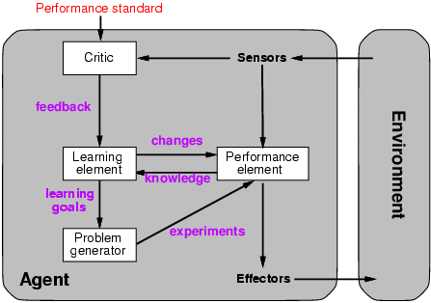
Learning agents
Actuators

Slide 4
Learning Agent
  Performance Element: Collection of knowledge and procedures to decide on the next action.
  Learning Element: takes in feedback from the critic and modifies the performance element accordingly.
  Critic: provides the learning element with information on how well the agent is doing based on a fixed performance standard.
  E.g. the audience
  Problem Generator: provides the performance element with suggestions on new actions to take.

Slide 5
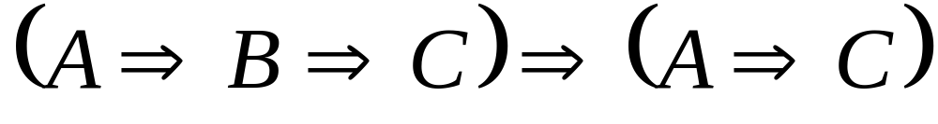
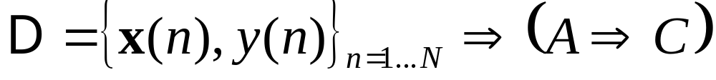
Two types of learning in AI
Deductive: Deduce rules/facts from already known rules/facts. (We have already dealt with this)
Inductive: Learn new rules/facts from a data set D.
We will be dealing with the latter, inductive learning, now

Slide 6
Inductive Learning
Key idea:
  To use specific examples to reach general conclusions
Given a set of examples, the system tries to approximate the evaluation function.
Also called Pure Inductive Inference

Slide 7
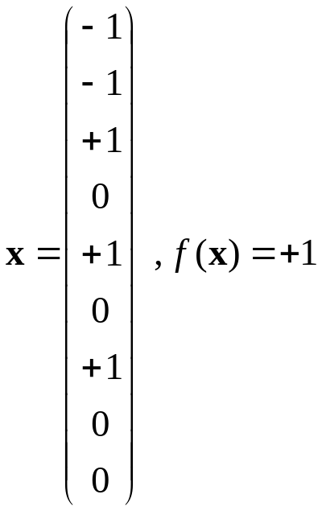
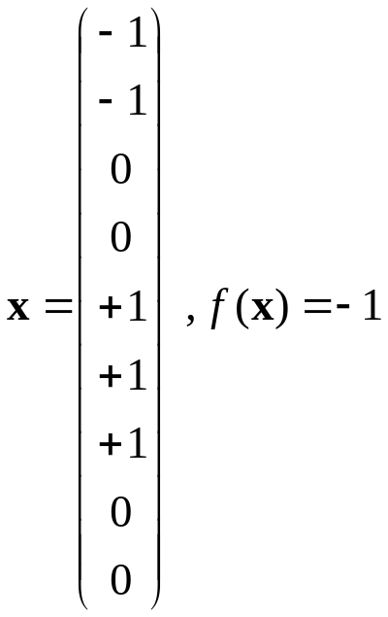
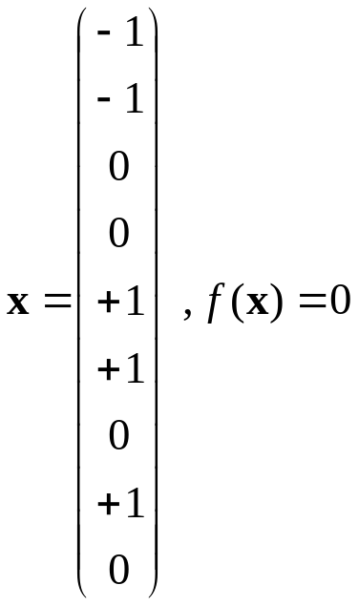
Inductive learning - example
 |  | 
 | 

 | 
 |  | 

 |  | 
 | 
 | 
Etc...
f(x) is the target function
An example is a pair [x, f(x)]
Learning task: find a hypothesis h such that h(x) ≈ f(x) given a training set of examples D = {[x_{i}, f(x_{i}) ]}, i = 1,2,…,N
Inspired by a slide from V. Pavlovic

Slide 8
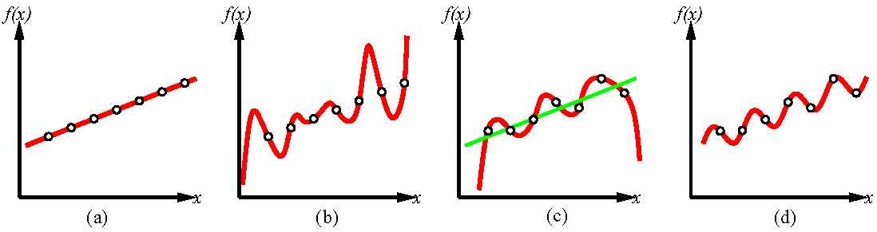
Inductive learning – example B
Inconsistent linear fit.
Consistent 6th order
polynomial fit.
Consistent sinusoidal
fit
Consistent linear fit
Consistent 7th order
polynomial fit
Construct h so that it agrees with f.
The hypothesis h is consistent if it agrees with f on all observations.
Ockham’s razor: Select the simplest consistent hypothesis.
How to achieve good generalization?

Slide 9
The idealized inductive learning problem
Find appropriate hypothesis space H and find
h(x) ∈ H with minimum “distance” to f(x) (“error”)
Error
f(x)
Η
h_{opt}(x) ∈ H
Our hypothesis space
The learning problem is realizable if f(x) ∈ H.

Slide 10
The real inductive learning problem
Find appropriate hypothesis space H and minimize
the expected distance to f(x) (“generalization error”)
⟨E_{gen}⟩
{f(x)}
Η
{h_{opt}(x)}
Data is never noise free and never available in infinite
amounts, so we get variation in data and model.
The generalization error is a function of both the
training data and the hypothesis selection method.

Slide 11
Hypothesis spaces (examples)
Η₁
f(x) = 0.5 + x + x² + 6x³
Η₃
Η₂
Η₁ ⊂ Η₂ ⊂ Η₃
Η₁={a+bx}; Η₂={a+bx+cx²}; Η₃={a+bx+cx²+dx³};
Linear; Quadratic; Cubic;

Slide 12






Types of Learning
  Supervised learning: correct answer for each example. Answer can be a numeric variable, categorical variable etc.
  The machine has access to a teacher who corrects it.
  Unsupervised learning: correct answers not given – just examples (e.g. – the same figures as above , without the labels).
  No access to teacher. Instead, the machine must search for “order” and “structure” in the environment.
  Reinforcement learning: occasional rewards
M
M
F
F
M
F

Slide 13
Learning problems
The hypothesis takes as input a set of attributes x and returns a ”decision” h(x) = the predicted (estimated) output value for the input x.
Discrete valued function ⇒ classification
Continuous valued function ⇒ regression

Slide 14
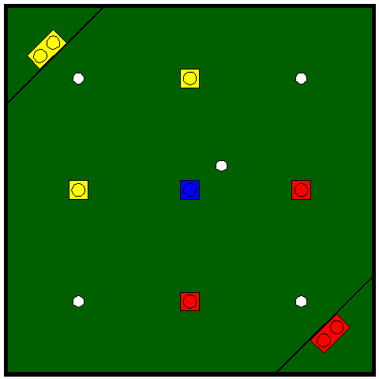
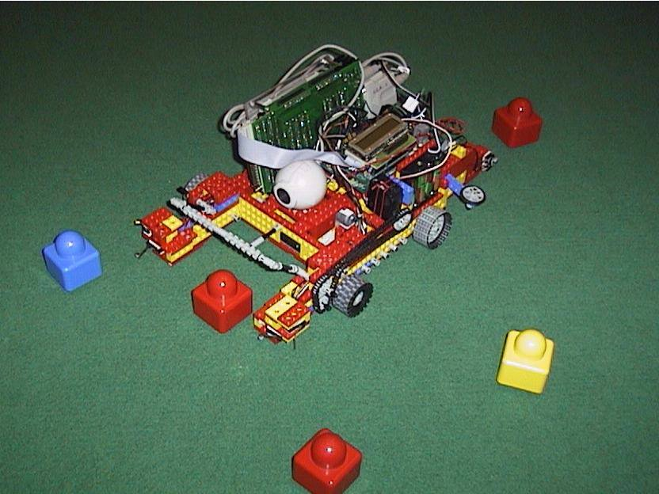
Example: Robot color vision
Classify the Lego pieces into red, blue, and yellow.
Classify white balls, black sideboard, and green carpet.
Input = pixel in image, output = category

Slide 15
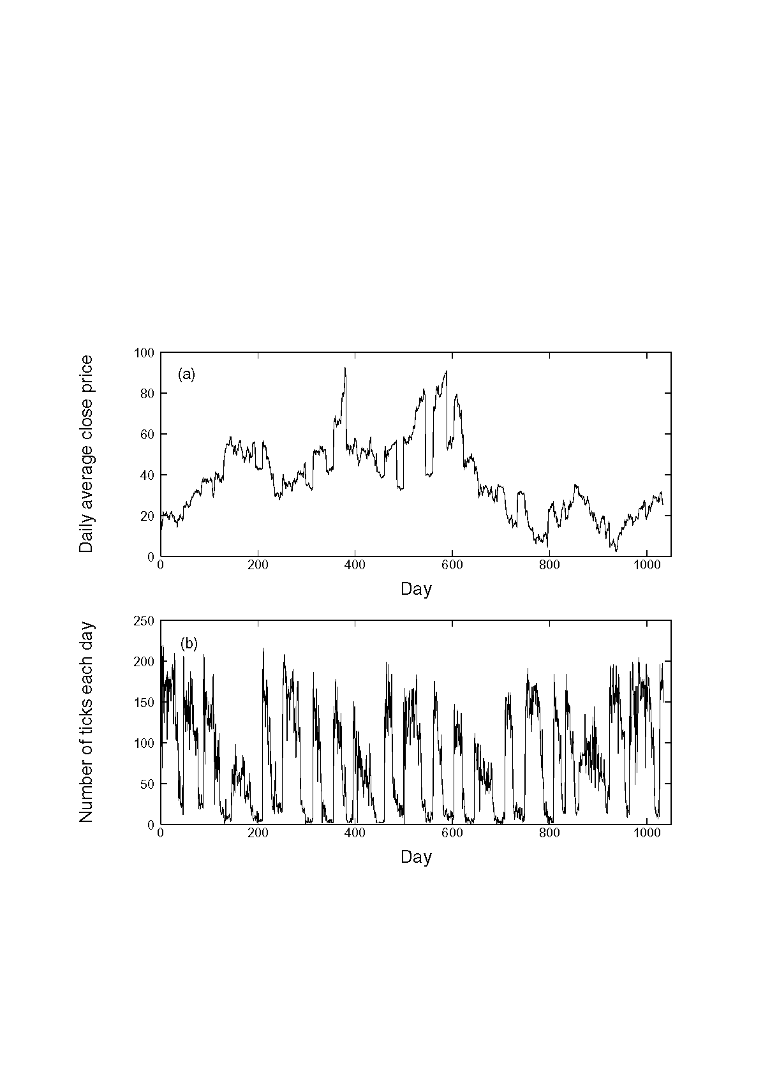
Example: Predict price for cotton futures
Input: Past history
of closing prices,
and trading volume
Output: Predicted
closing price

Slide 16
Method: Decision trees
“Divide and conquer”:
Split data into smaller and smaller subsets.
Splits usually on a single variable
x₁ > α ?
yes
no
x₂ > β ?
x₂ > γ ?
yes
no
yes
no

Slide 17
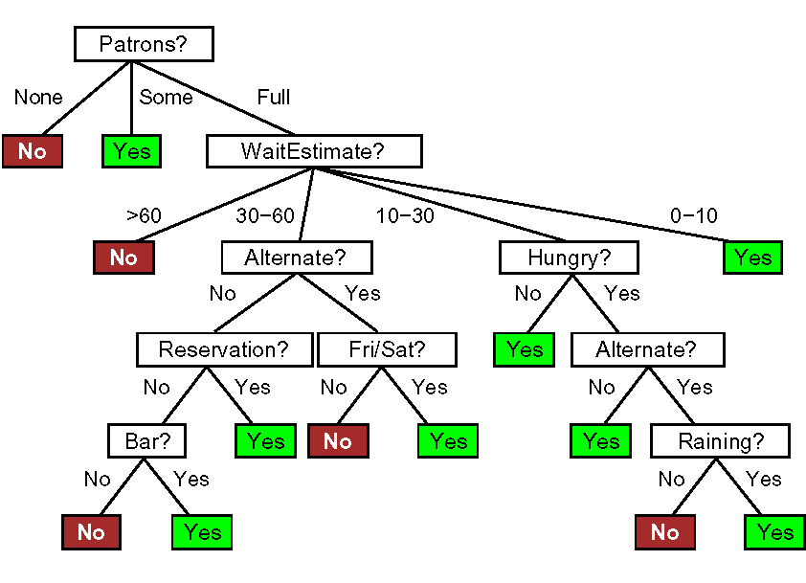
The wait@restaurant decision tree
This is our true function.
Can we learn this tree from examples?

Slide 18
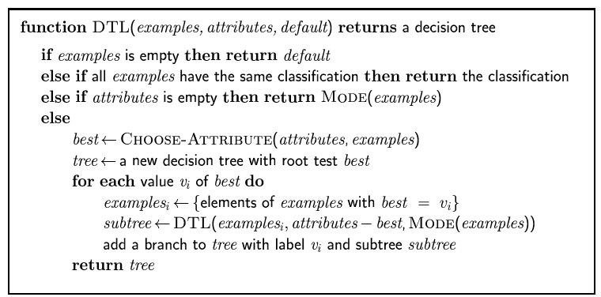
Decision tree learning
Aim: find a small tree consistent with the training examples
Idea: (recursively) choose "most significant" attribute as root of (sub)tree
Notes:
Explain specifically:
best
Mode(examples) השכיח של המטרה בדוגמאות בתת עץ זה

Slide 19
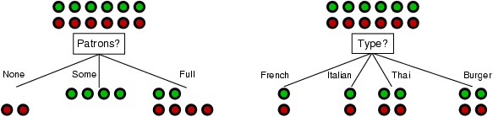
Choosing an attribute
Idea: a good attribute splits the examples into subsets that are (ideally) "all positive" or "all negative"
Patrons? is a better choice

Slide 20
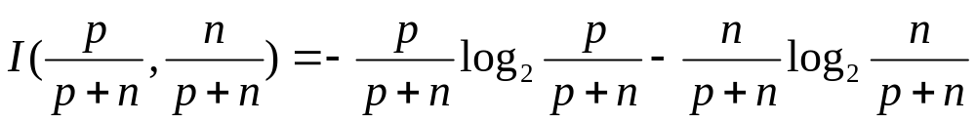
Using information theory
To implement Choose-Attribute in the DTL algorithm
Information Content (Entropy):
I(P(v₁), … , P(v_{n})) = Σ_{i=1} -P(v_{i}) log₂ P(v_{i})
For a training set containing p positive examples and n negative examples:

Slide 21
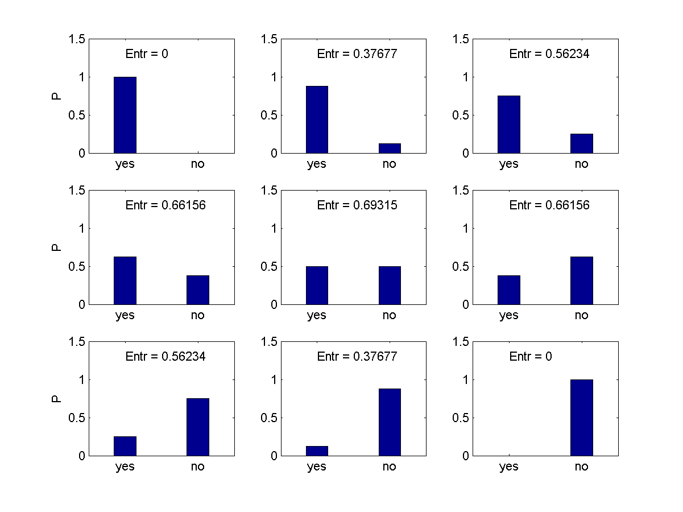
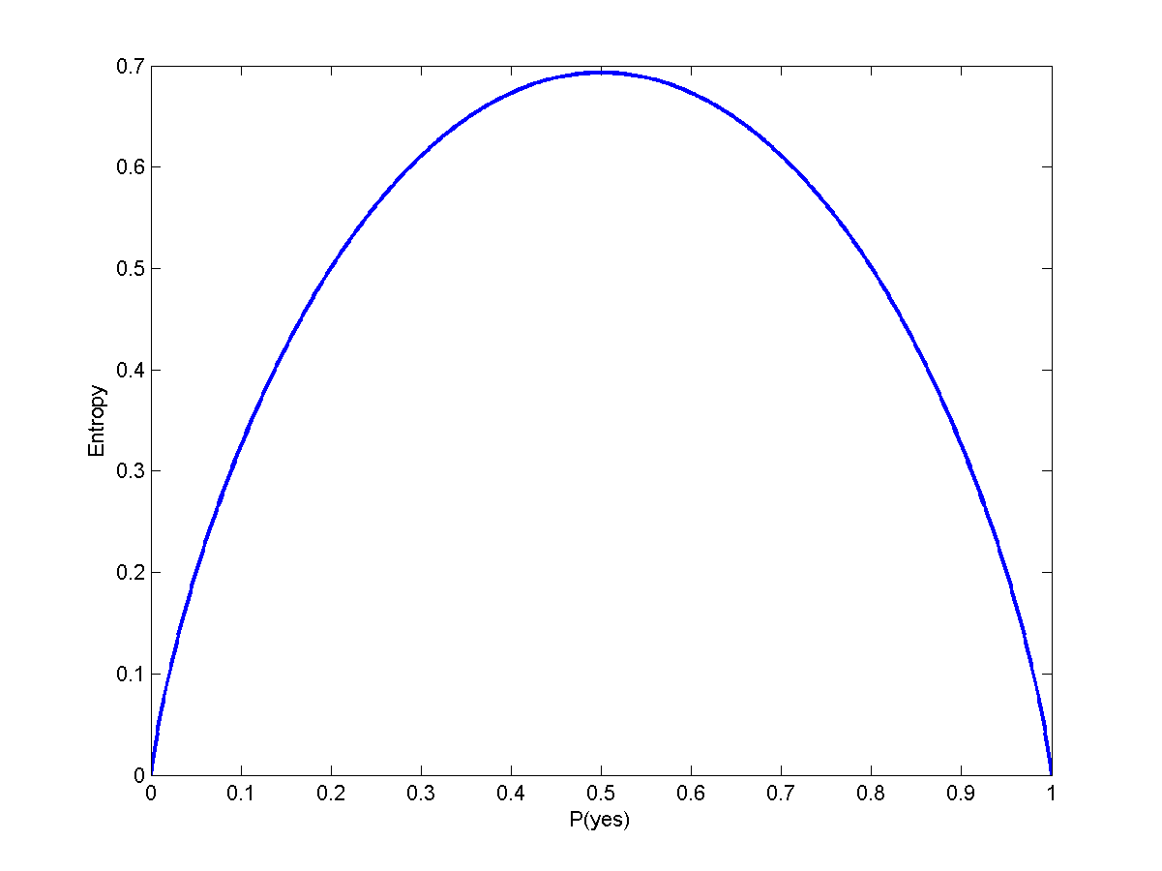
The entropy is maximal when
all possibilities are equally
likely.
The goal of the decision tree
is to decrease the entropy in
each node.
Entropy is zero in a pure ”yes”
node (or pure ”no” node).
Entropy is a measure of ”order” in a
system.
The second law of thermodynamics:
Elements in a closed system tend
to seek their most probable distribution;
in a closed system entropy always increases

Slide 22
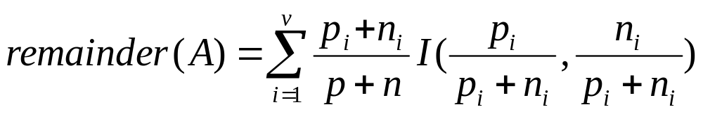
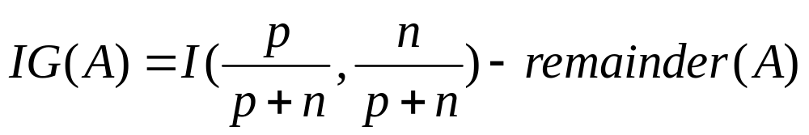
Information gain
A chosen attribute A divides the training set E into subsets E₁, … , E_{v} according to their values for A, where A has v distinct values.
Information Gain (IG) or reduction in entropy from the attribute test:
Choose the attribute with the largest IG

Slide 23
Decision tree learning example
10 attributes:
Alternate: Is there a suitable alternative restaurant nearby? {yes,no}
Bar: Is there a bar to wait in? {yes,no}
Fri/Sat: Is it Friday or Saturday? {yes,no}
Hungry: Are you hungry? {yes,no}
Patrons: How many are seated in the restaurant? {none, some, full}
Price: Price level {$,$$,$$$}
Raining: Is it raining? {yes,no}
Reservation: Did you make a reservation? {yes,no}
Type: Type of food {French,Italian,Thai,Burger}
Wait: {0-10 min, 10-30 min, 30-60 min, >60 min}

Slide 24
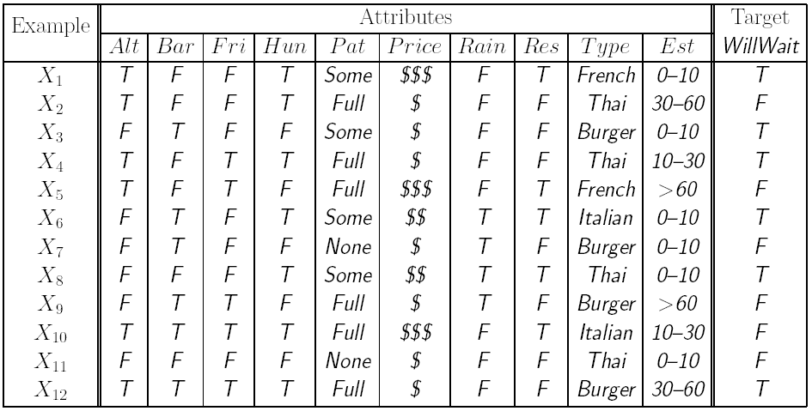
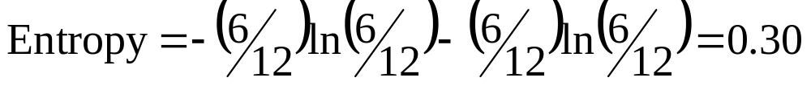
Decision tree learning example
T = True, F = False
6 True,
6 False

Slide 25
Decision tree learning example
Alternate?
Yes
No
3 T, 3 F
3 T, 3 F
Entropy decrease = 0.30 – 0.30 = 0

Slide 26
Decision tree learning example
Bar?
Yes
No
3 T, 3 F
3 T, 3 F
Entropy decrease = 0.30 – 0.30 = 0

Slide 27
Decision tree learning example
Sat/Fri?
Yes
No
2 T, 3 F
4 T, 3 F
Entropy decrease = 0.30 – 0.29 = 0.01

Slide 28
Decision tree learning example
Hungry?
Yes
No
5 T, 2 F
1 T, 4 F
Entropy decrease = 0.30 – 0.24 = 0.06

Slide 29
Decision tree learning example
Raining?
Yes
No
2 T, 2 F
4 T, 4 F
Entropy decrease = 0.30 – 0.30 = 0

Slide 30
Decision tree learning example
Reservation?
Yes
No
3 T, 2 F
3 T, 4 F
Entropy decrease = 0.30 – 0.29 = 0.01

Slide 31
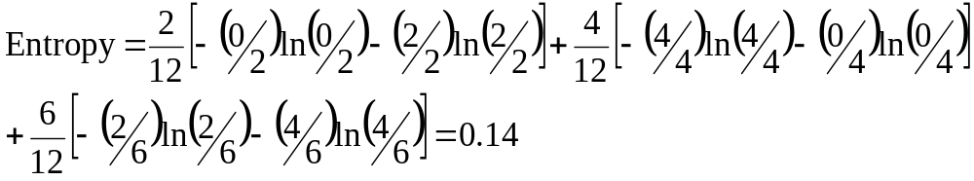
Decision tree learning example
Patrons?
None
Full
2 F
Some
2 T, 4 F
4 T
Entropy decrease = 0.30 – 0.14 = 0.16

Slide 32
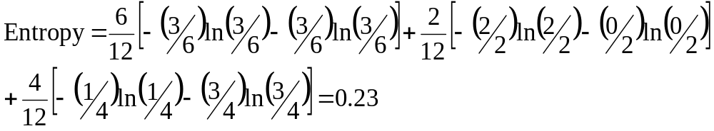
Decision tree learning example
Price
$
$$$
3 T, 3 F
$$
1 T, 3 F
2 T
Entropy decrease = 0.30 – 0.23 = 0.07

Slide 33
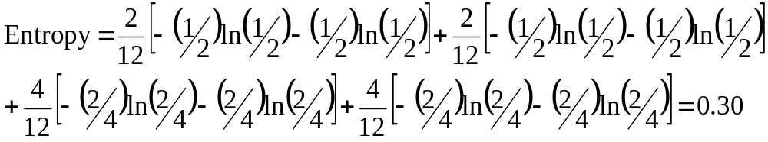
Decision tree learning example
Type
French
Burger
1 T, 1 F
2 T, 2 F
Italian
Thai
1 T, 1 F
2 T, 2 F
Entropy decrease = 0.30 – 0.30 = 0

Slide 34
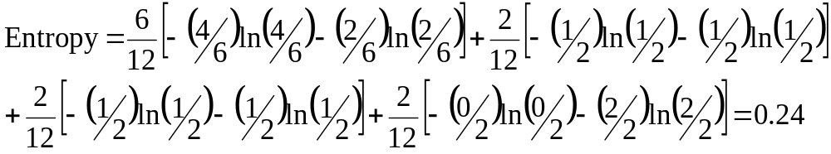
Decision tree learning example
Est. waiting
time
0-10
> 60
4 T, 2 F
2 F
10-30
30-60
1 T, 1 F
1 T, 1 F
Entropy decrease = 0.30 – 0.24 = 0.06

Slide 35
Decision tree learning example
Patrons?
Largest entropy decrease (0.16)
achieved by splitting on Patrons.
None
Full
2 F
Some
X?
2 T, 4 F
Continue like this, making new splits, always purifying nodes.
4 T

Slide 36
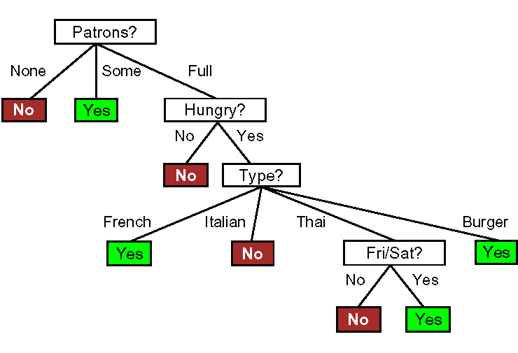
Decision tree learning example
Induced tree (from examples)

Slide 37
Decision tree learning example
True tree

Slide 38
Decision tree learning example
Induced tree (from examples)
Cannot make it more complex
than what the data supports.

Slide 39
Assessing the Performance of the Learning Algorithm
A learning algorithm is good if it produces hypotheses that do a good job of predicating the classifications of unseen examples
Test the algorithm’s prediction performance on a set of new examples, called a test set.

Slide 40
Methodology in Accessing Performance
Collect a large set of examples.
Divide it into 2 disjoint set: the training set and the test set. It is very important that these 2 sets are separate so that the algorithm doesn’t cheat. Usually this division of examples is done randomly.
Use the learning algorithm with the training set as examples to generate a hypothesis H.
Measure the percentage of examples in the test set that are correctly classified by H.
Repeat steps 1 to 4 for different sizes of training sets and different randomly selected training sets of each size.

Slide 41
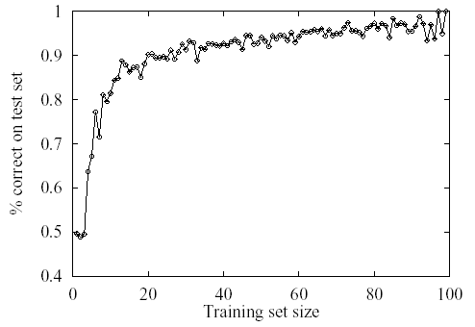
Learning curve for the decision tree algorithm on 100 randomly
generated examples in the restaurant domain.
The graph summarizes 20 trials.

Slide 42
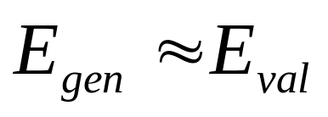
Cross-validation
Use a “validation set”.
Split your data set into two
parts, one for training your
model and the other for
validating your model.
The error on the validation
data is called “validation error”
(E_{val})
D_{train}
D_{val}
E_{val}

Slide 43
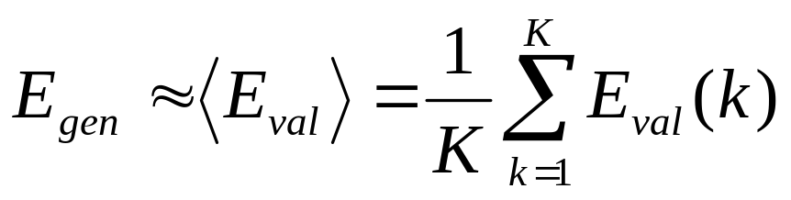
K-Fold Cross-validation
More accurate than using only one validation set.
D_{train}
D_{val}
D_{train}
D_{val}
D_{train}
D_{val}
D_{train}
E_{val}(1)
E_{val}(2)
E_{val}(3)

Slide 44
Learning General Logical Descriptions
Key idea:
  Look at inductive learning generally
  Find a logical description that is equivalent to the (unknown) evaluation function
Make our hypothesis more or less specific to match the evaluation function.

Slide 45
Current-best-hypothesis Search
Key idea:
  Maintain a single hypothesis throughout.
  Update the hypothesis to maintain consistency as a new example comes in.

Slide 46
Definitions
Positive example: an instance of the hypothesis
Negative example: not an instance of the hypothesis
False negative example: the hypothesis predicts it should be a negative example but it is in fact positive
False positive example: should be positive but it is actually negative.

Slide 47
Current-best-hypothesis Search Algorithm
1. Pick a random example to define the initial hypothesis
2. For each example,
  In case of a false negative:
    Generalize the hypothesis to include it
  In case of a false positive:
    Specialize the hypothesis to exclude it
3. Return the hypothesis

Slide 48
How to Generalize
Replacing Constants with Variables:
Object(Animal,Bird) → Object (X,Bird)
Dropping Conjuncts:
Object(Animal,Bird) & Feature(Animal,Wings)
→ Object(Animal,Bird)
Adding Disjuncts:
Feature(Animal,Feathers) → Feature(Animal,Feathers) v
Feature(Animal,Fly)
Generalizing Terms:
Feature(Bird,Wings) → Feature(Bird,Primary-Feature)
http://www.pitt.edu/~suthers/infsci1054/8.html

Slide 49
How to Specialize
Replacing Variables with Constants:
Object (X, Bird) → Object(Animal, Bird)
Adding Conjuncts:
Object(Animal,Bird) → Object(Animal,Bird) &
Feature(Animal,Wings)
Dropping Disjuncts:
Feature(Animal,Feathers) v Feature(Animal,Fly)
→ Feature(Animal,Fly)
Specializing Terms:
Feature(Bird,Primary-Feature) → Feature(Bird,Wings)
http://www.pitt.edu/~suthers/infsci1054/8.html

Slide 50
Potential Problem of Current-best-hypothesis Search
Extension made not necessarily lead to the simplest hypothesis.
May lead to an unrecoverable situation where no simple modification of the hypothesis is consistent with all of the examples.
The program must backtrack to a previous choice point.

Slide 51
Problem of Backtracking
Require large space to store all examples
Need to check all previous instances after each modification of the hypothesis.
Search and check all these previous instances over again after each modification is very expensive

Slide 52
Version Space Learning Algorithm
Least-Commitment Search
No backtracking
Key idea:
  Maintain the most general and specific hypotheses at any point in learning. Update them as new examples come in.

Slide 53
Definitions
Version space: a set of all hypotheses consistent with examples seen so far
Boundary sets: sets of hypotheses defining boundary on which hypotheses are consistent with examples
  Most general (G-set) and most specific (S-set) boundary sets

Slide 54
Requirement
Usually requires an enormous number of hypotheses to record.
An assumption: a partial ordering (more-specific-than ordering) exists on all of the hypotheses in the space
  hierarchical
Boundary sets circumscribing the space of possible hypotheses.
  G-set(the most general boundary)
  S-set (the most specific boundary)

Slide 55
Version Space Learning Algorithm
1. Initially, the G-set is True, and the S-set is False
2. For each new example, there are 6 possible cases:
  a) false positive for S_{i} in S
    S_{i} is too general - no consistent specializations.
    Throw it out.
  b) false negative for S_{i} in S
    S_{i} is too specific.
    Replace it with its generalizations.

Slide 56
Version Space Learning Algorithm (con’t)
c) false positive for G_{i} in G
    G_{i} is too general.
    Replace it with its specializations.
d) false negative for G_{i} in G
    G_{i} is too specific - no consistent generalizations.
    Throw it out.
e) S_{i} more general than some other hypothesis in S or G
    Throw it out.
f) G_{i} more specific than some other hypothesis in S or G
    Throw it out.

Slide 57
Version Space Learning Algorithm (con’t)
3. Repeat the process until one of three things happens:
  a) Only one hypothesis left in the version space.
    This is the answer we want.
  b) The version space collapses, i.e. either G or S becomes empty.
    This means there are no consistent hypotheses.
  c) We run out of examples while the version space still has several hypotheses.
    Use their collective evaluation (breaking disagreements with majority vote).

Slide 58
Advantages of the Algorithm
Never favor one possible hypothesis over another; all remaining hypotheses are consistent
Never require backtracking

Slide 59
Potential Problems
Does not deal with noise
  Not very practical in real-world learning problem
Unlimited disjunctions in the version space leads to
  The S-set has a single most specific hypothesis
  The G-set has a most general hypothesis

